Slide 1
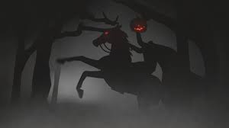
“The Legend of sleepy hollow”
Author: Washington Irving
Focus: Understanding Legends and the Mood of a Play

Slide 2
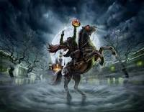
Background video and quiz
Go to your Language Arts Google Classroom page and select the assignment for “The Legend of Sleepy Hollow” as preparation for this lesson.
https://classroom.google.com/

Slide 3
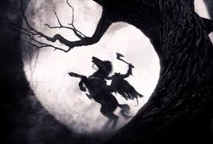
Essential Question #1
How can examining legends help readers understand history?
A legend is a story, which has some basis in truth that has been passed down from generation to generation, either through the oral or written tradition. Most legends represent an event or person that truly existed.

Slide 4
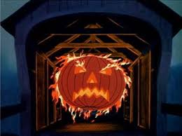
Essential Question #2
How can a reader analyze the mood of a drama/play?
Readers can look at the feelings created through the dialogue and actions of the characters as well as through the stage directions presented by the playwright. In a play, the actors themselves influence the mood through their interpretation and presentation of the drama.

Slide 5
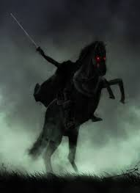
Legends: origins of the headless horseman
Most legends have their origins in truth, including the legend of the headless horseman.
Ghost of a soldier from the Revolutionary War, beheaded by a cannonball in some unnamed battle
Travels nightly in search of his head.
Possibly a local tale told to Irving when he lived along the Hudson River
Possibly old bit of folklore that actually preceded the Revolution passed down by the descendants of Dutch settlers.
Older European traditions, arguing that Irving was inspired by legends of the “Wild Huntsman,” a ghostly rider who terrified nighttime travelers with his pack of hounds in Medieval Germany.

Slide 6
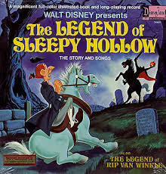
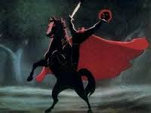
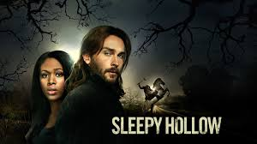
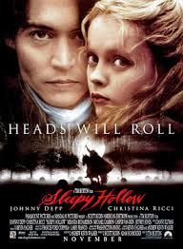
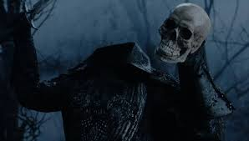
Headless Horseman in Pop culture
Film and TV Adaptations of the Original Text—

Slide 7
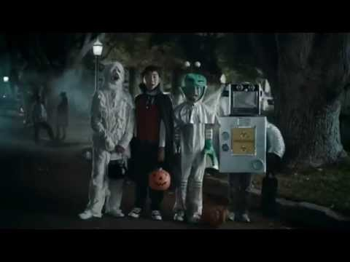
Headless Horseman in Pop Culture

Slide 8
Post-Reading Activities
Complete the activities on the guided reading handout for this text.

