Slide 1
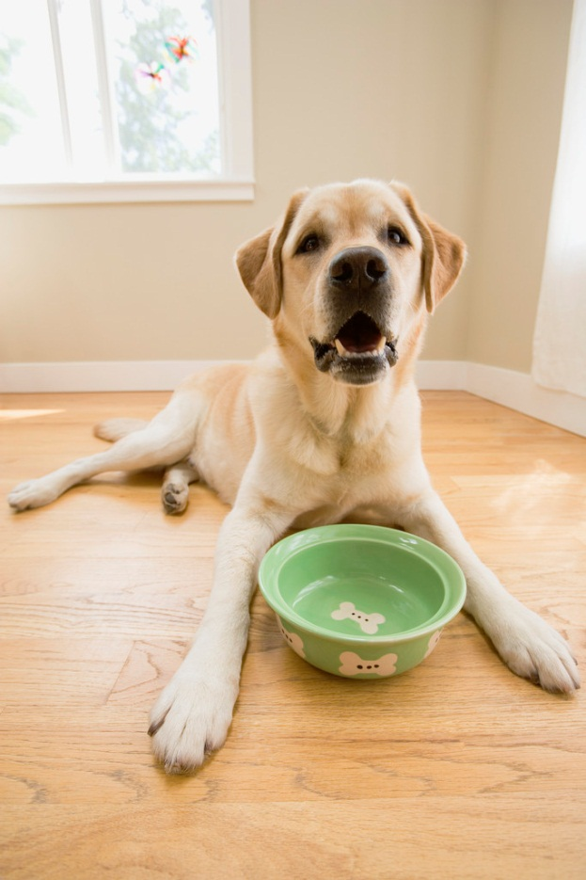
My Life in Dog Years
By Gary Paulsen

Slide 2
Gary Paulsen
What do you remember about him?
Jobs he had
His feelings about animals
Activities he enjoys
How did he become a proficient writer?
What do you know about his dog, Cookie?
From Woodsong
Did he always want to be famous?

Slide 3
About the Author
http://www.penguinrandomhouse.com/search/gary-paulsen?q=gary%20paulsen

Slide 4
A Video Interview with Gary Paulsen
http://www.youtube.com/watch?v=Q7ADtOjxmRs

Slide 5
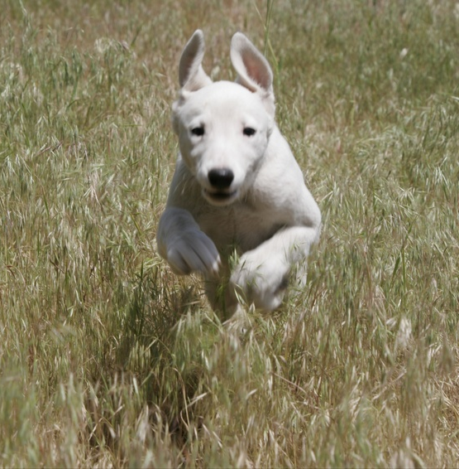
Cookie
Vocabulary – Write the following words
Dedication
Unabashedly
Lead Dog
Pounds
Mandatory

Slide 6
Cookie
1. Despite the blizzard conditions, he knew he could count on the __________ to follow his commands and take the team and himself to safety.
2. __________ often accept donations of pet food and money to help support the animals they hope will be adopted.
3. At the beginning of the movie, there was a ___________ to the movie producer’s father.
4. Before you can get your driver’s license, it is __________ that you pass a written test.
5. After being away in the army for months, he ___________ kissed all of his relatives at a holiday gathering.

Slide 7
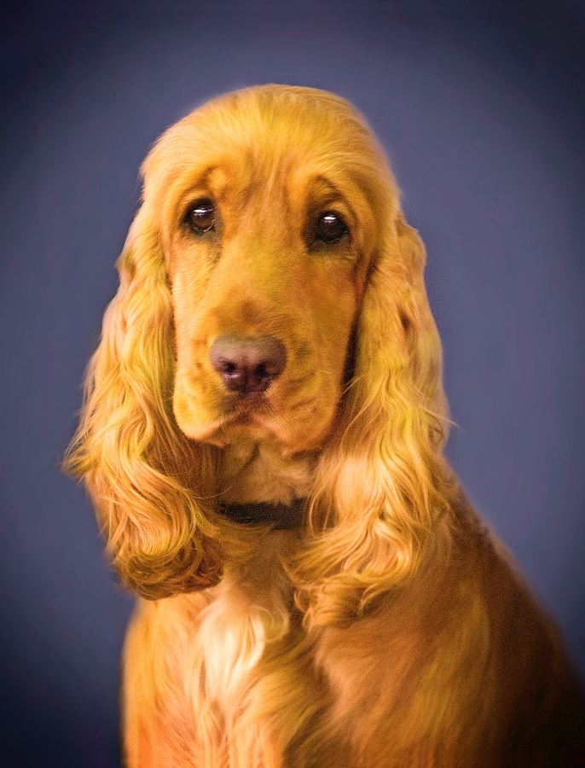
Cookie
Comprehension Questions:
1. What are two things that make the ice near beaver lodges thin?
2. What two things saved Paulsen?
3. After Cookie rescued Paulsen by rallying the team to pull him out, what danger did he still face and what did he do to save himself?

Slide 8
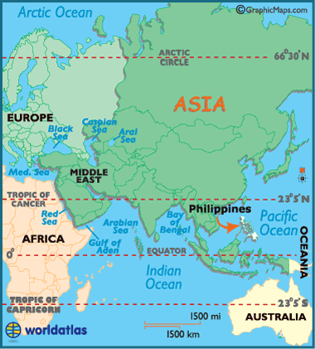
Philipinnes
The Philippines is a group of over 7,100 islands in the Pacific Ocean.
In 1946, after many years under the U.S. and Japan’s control, the Philippines became an independent nation.

Slide 9
___Philippine Islands (9) ___ haggle (11) ___ civilian (12) ___ravaged (12) ___cockfights (15) ___paddies (15) ___ jauntily(18) ___beckon (18)
Snowball
playfully; in a carefree manner
Deadly fights between rooster, staged for human entertainment and gambling
To call or invite
A country of more than 7,000 islands; it was a possession of the U.S. before World War II
To argue back and forth over a price
Wet fields in which rice grows
Destroyed
A person who is not a member of a police force or any branch of the military

Slide 10
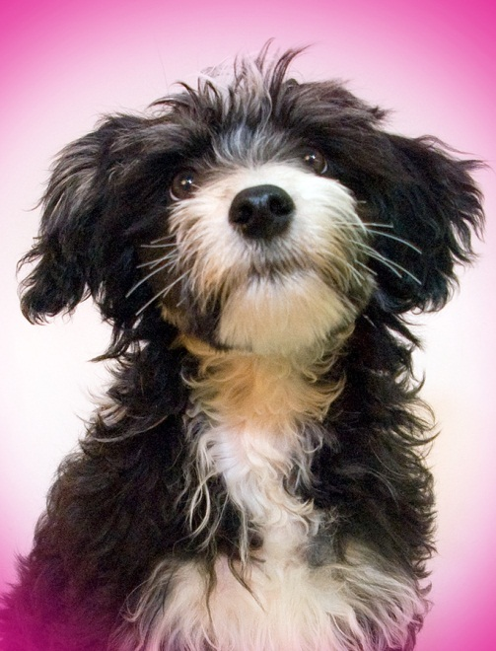
1. Why did young Paulsen first take the puppy? 2. How did Snowball get her name? 3. Describe Paulsen’s parents. 4. Describe the setting of this chapter? 5. Why was the setting important to the relationship between Paulsen and Snowball? 6. How did Snowball die?
Snowball

Slide 11
Ike
Use 10 of the following words to complete the crossword puzzle. If you are unsure of the meaning, try reading the word in context on the page number listed.
Solitude (19)
Isolation (19)
Excruciatingly (19)
Salvation (20)
Visceral (22)
Palpable (22)
Dappled (22)
Decoys (23)
Blinds (23)
Entity (24)
Roundhouse (24)
Mallard (29)
Teal (29)
Scorn (33)
Compelled (33)
Absolve (33)

Slide 12
Dirk
Although Paulsen had parents, he calls himself a “street kid.” Why?
What jobs did Paulsen have in this chapter?
Why was going home after work scary for Paulsen?
How did Paulsen find Dirk?
Paulsen said he didn’t go to the authorities because he was from “the wrong side of the tracks.” What did he mean by that?

Slide 13
Dirk
6. Why does Paulsen name the dog Dirk?
7. Why do Paulsen’s attackers run away?
8. How does Dirk react when Paulsen tries to pet him the first time?
9. Why does Paulsen say Dirk “came to a wonderful end?”
10. What does Dirk do when Olaf pets him?

Slide 14
Rex
MY GUESS
MY GUESS
MY GUESS
SENTENCE
FROM BOOK
MY NEW GUESS
SENTENCE
FROM BOOK
MY NEW GUESS
WORD
Combine
(P. 55)
Materialized
(P. 59)
Veld
(P. 64)
Crude
(P. 61)
Forays
(P. 64)
Notes:
Students should complete the first two columns BEFORE they look up the words in the book.

Slide 15
Rex
Select one of the dogs we have read about previously and compare that dog to Rex using a Venn Diagram.
Rex
Dog #2

Slide 16
Activity-homework after Rex
Bring in a picture of a pet you currently own or have owned in the past. If you have not had a pet, bring in (or draw) a picture of a pet you would like to have one day.
Be prepared to tell a short story about the pet in a small group tomorrow.

Slide 18
Character Traits
Adventurous Friendly Proud
Athletic Fun-Loving Protective
Active Gentle Quiet
Brave Generous Smart
Bold Happy Selfish
Caring Humble Timid
Cheerful Hostile Wild
Curious Honest Loyal
Considerate Independent Fierce
Courageous Lazy Nurturing
Considerate Mischievous
Energetic Nice

Slide 19
Caesar
Character Trait
Caesar’s actions that support this trait
Gary’s thoughts that support this trait

Slide 20
1. Why did Paulsen buy Fred even after Fred bit him? 2. Why did he give the puppy the name Fred? 3. Paulsen describes his life as “close to the land.” What does that mean? Give some examples. 4. What was the neighbor’s recommendation for keeping Pig out of the garden? 5. What did Paulsen forget when he put the fence around the pigpen? 6. How did Fred react to the electric fence wire? 7. Why does Paulsen say that Fred won? 8. Was Paulsen successful in raising Pig for bacon and ham?
Fred and Pig

Slide 21
Quincy
MY GUESS
SENTENCE
FROM BOOK
MY NEW GUESS
WORD
daunting (106)
wreaked havoc (113)
precarious (113)
tableau (112)
rogues (114)

Slide 22
Quincy
How close were you?
Daunting – Scary; frightening
Wreaked havoc – caused great destruction
Precarious – Unstable; uncertain
Tableau – a picture
Rogues – destructive animals whose behavior is different from most of their species

Slide 23
Quincy
Put the following event in the order in which they happened.
_____ a. Paulsen and his friend the carpenter drove to Alaska in an old truck.
_____ b. Quincy journeyed 30 miles through Alaskan wilderness to the cabin of a woman and her two children.
_____ c. Bemidji held fundraisers to help Paulsen finance his dream of competing in the Iditarod.
_____ d. Paulsen decided he wanted to run the Iditarod.
_____ e. Paulsen discovered that his Siberian Husky could haul only thirty miles.

Slide 24
Josh
Comprehension True or False:
_____ 1. Josh is a Border collie.
_____ 2. Josh had an owner before Paulsen who thought he was “naughty.”
_____ 3. Josh is afraid of horses.
_____ 4. Josh doesn’t like to get his paws dirty digging at things.
_____ 5. When there are guests at the house, Josh tries to herd them into one room.
_____ 6. Josh escorts all house guests to their cars.
_____ 7. At the international Border collie field trials, Paulsen saw hundreds of Border collies on short leashes following their owners.

Slide 25
Josh
_____ 8. Border collies love to listen and learn.
_____ 9. Josh will fetch an object as many times as Paulsen will throw it.
_____10. After feeling insulted that Paulsen would have him catch a rat, Josh left a dead gopher in his boot.
_____11. When Josh is too serious, Paulsen tickles his ribs.
_____12. When Paulsen was depressed, Josh tried to tickle his ribs.
_____13. Josh refused to be harnessed as a sled dog with the team.
_____14. Paulsen has a heart condition that keeps him from competing in sled dog racing.
_____15. On the Bighorn Mountain trail, Josh plays the role of point before the horses, thus making sure Paulsen won’t be thrown from a spooked horse.

