Slide 1
Montmorency:
Movie Trailer
Thief, Liar, Gentleman?
By: Eleanor Updale

Slide 2
Comprehension

Slide 3
About the Author
http://eleanorupdale.com/

Slide 4
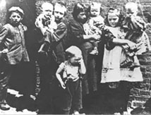
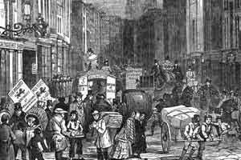
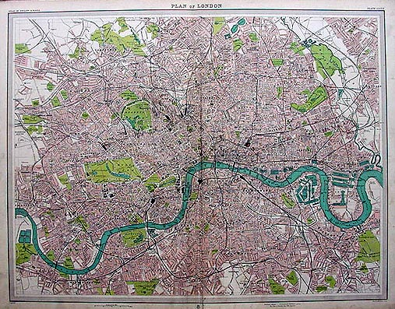
London 1875
What do you think London would have been like in 1875?

Slide 5
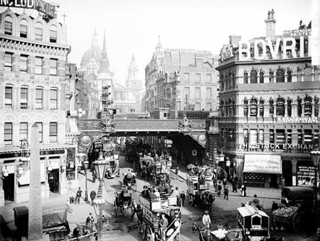
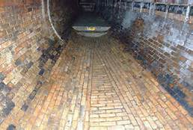
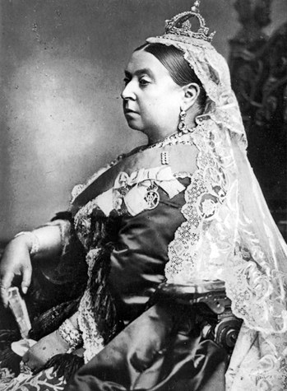
Setting
The streets and newly built sewer system of London
Victorian England
During Queen Victoria's
reign (1837-1901)

Slide 6
Sewers
London was a fast-growing city and people wanted a better quality of life
People would have been ill because of the poor standards of hygiene
The River Thames would have been like one big sewer

Slide 7
Characters
Montmorency, Scarper, Prisoner 493
All characters are fictional except Sir Joseph Bazalgette – chief engineer for London’s Metropolitan Board of Works and responsible for building London’s sewer system.

Slide 8
Introducing the text
Study the front cover of the novel and read the blurb
Where is the story set? What do you know about this setting?
Who is the main character in the novel?
How does he manage to escape death?
Why is he leading a double life? What possible complications could leading a double life cause?
How do you think he has been able to get away with so many robberies?
Make some predictions about what is going to happen in the novel.

Slide 9
Comprehension Ch. 1-3
1-When and where is the story set?
2-Where is Montmorency?
3-Why is he in so much pain?
4-Who saved Montmorency’s life?
5-What was the Doctor’s motivation for taking on Montmorency’s case?
6-How did Montmorency get his name?
7-Why is Montmorency so interested by Sir Joseph Bazalgette’s lecture about London’s new sewerage system?
8-What does Bazalgette produce during his lecture that provides Montmorency with invaluable information?
9-How does Montmorency go about gathering information that will help him with his new life?

Slide 10
Discussion
Describe the setting of the story.
What do we know about Montmorency so far? Develop a character profile for him and add to it as you keep reading the story.
Describe Doctor Farcett. Does his motivation for taking on Montmorency’s case influence your opinion about him? Explain your answer.
Make some predictions about what is going to happen next.

Slide 11
Comprehension Chpts. 4-6
1-Describe the conditions in prison.
2-Who does Montmorency share his cell with?
3-Why is Montmorency so unpopular with the other prisoners?
4-What sorts of things do the prisoners do to him to make his life in prison worse?
5-What does Doctor Farcett suggest to Marston that he have Montmorency do to improve his muscle tone?
6-What does Montmorency notice when he and Dr. Farcett stop at the Doctor’s house? How might Montmorency be able to use this information in the future?
7-How do the men at the Scientific Society treat Montmorency? Who is the only one who shows him any kindness?

Slide 12
Theme
From what you’ve read in the novel, discuss the treatment of prisoners in the jails of Victorian England. How were inmates regarded by the system? How were they treated by other inmates? Is it any different today in our jails?

Slide 13
Comprehension Questions 7-10
1-How does Montmorency propose to amass funds and be able to enjoy the wealth without arousing suspicions?
2-What problems does Montmorency see with his plan?
3-How does he solve this problem?
4-What name does Prisoner 493 choose for his upper class self? What does he call the lower class thief?
5-What surprising news does the Governor give Montmorency when he calls him into his office?
6-Who does Montmorency see when he leaves the prison? How is this person different in “real life”? What does Montmorency take from him?
7-What does Scarper discover when he tries to open the manhole?
8-Where does Scarper find the perfect manhole for his purpose?
9-Where does Scarper rent a room? What is the room like?
10-What does Scarper steal from the pub?

Slide 14
Comprehension Questions 11-14
1-What difficulties does Scarper have when he first goes down the sewers? What lessons does he learn for the future?
2-What is the first job that Scarper pulls off using the sewerage system as an escape route?
3-Who are the “flushers”? Describe Scarper’s first encounter with them.
4-What strange things has Scarper found in the sewers?
5-Why does Scarper believe that he was lucky to find Mrs. Evans and Vi? How is it that his strange comings and goings go unnoticed?
6-What does Scarper learn from the newspaper article that he reads?

Slide 15
Discussion
Describe Scarper. Why isn’t he a very nice man? What talents and skills does he have? Do you believe that his actions are justified?
How do you think that Scarper is going to become Montmornecy? Where will Montmorency live? How will Scarper be able to change into Montmorency without arousing suspicion? What will Montmorency need to have to pass as a member of the upper class?

Slide 16
Comprehension 15-17
1-What does Scarper steal from Robert Farcett’s house?
2-What does Scarper put in his letter?
3-Where does Montmorency take up residence?
4-Describe the hotel.
5-What is Mr. Longman’s daughter, Cissie, like?
6-Who does Montmorency model his stance and manners on?
7-What else does he do to ensure that he will pass as a member of the upper class?

Slide 17
Comprehension 18-21
1-What problems does Cissie cause for Montmorency?
2-How does Montmorency deal with her unwanted attentions?
3-Who is Montmorency’s tailor?
4-What interesting news does Montmorencylearn from him about Lady Bevington?
5-Why does Montmorency visit Mr. Rigby?
6-How is Mr. Rigby able to identify the hat as belonging to Dr. Farcett?
7-How does Montmorency react when Mr. Rigby expresses surprise?
8-Who does Montmorency believe is responsible for the Bevington robbery?

Slide 18
Discussion
1-How do you think that Montmorency will deal with the unexpected development of Mr. Rigby recognizing Farcett’s hat?
2-What do you think will happen if Rigby sees Farcett and mentions it to him?
3-How does Montmorency react when he realizes that Freakshow is going to hang for the crimes that he has committed?
4-What does this make him realize about his own situation?

Slide 19
Comprehension 22-23
1-How does Montmorency solve the problem with Mr. Rigby?
2-What startling news does Mr. Lyons give Montmorency?
3-How does Montmorency react when Mr. Lyons notices his scars?
4-Describe Montmorency’s experience at the opera?

Slide 20
Discussion
1.How do you think that Montmorency will deal with the unexpected development of Mr. Rigby recognizing Farcett’s hat? What do you think will happen if Rigby sees Farcett and mentions it to him?
2.How does Montmorency react when he realizes that Freakshow is going to hang for the crimes that He has committed? What does this make him realize about his own situation?

Slide 21
Comprehension 24-26
1. What does Montmorency overhear the flushers saying that scares him? Why do the flushers believe that someone would be in the sewers?
2. Describe Freakshow’s trial. Do you believe it was fair? Explain your answer. What is his punishment?
3. Why does Montmorency feel shame when Freakshow’s sentence is handed down?
4. Why is Montmorency reluctant to go back down the sewers after Freakshow’s trial?
5. Why does Montmorency return to the Scientific Society? How is his visit different from his previous visits?
6. What information does Montmorency obtain during the lecture that convinces him to let Scarper get back to work? What treasure has Scarper stolen by the end of the night?

Slide 22
Comprehension 27-29
1. How does Scarper get the idea to raid the silversmith in Blackfriars?
2. What causes the surge of water in the sewerage system? Describe Scarper’s close encounter with death. How does he ensure his survival? Who eventually rescues him?
3. What story does Montmorency concoct for Mr. Longman to explain his injuries? How does Scarper build on the story?
4. Why does Montmorency decide to walk in the park? Why does he decide to let Cissie accompany him on these walks?

Slide 23
Comprehension 30-33
1. Describe how Montmorency and Lord George Fox-Selwyn become friends. Where does Fox-Selwyn invite Montmorency?
2. How does Fox-Selwyn come to meet Doctor Farcett? What does he learn when he goes to Farcett’s house?
3. Describe Bargles. How well does Montmorency fit in at the club? What sort of things do Montmorency and Fox-Selwyn do together?
4.Who is sir Gordon Pewley? How does Fox-Selwyn feel about him? Why does he feel this way?
5. Why does Montmorency have to change his shirt? Do you think that Fox-Selwyn realizes who Montmorency is? Why doesn’t he say anything?

Slide 24
Comprehension 34-36
1. What does Fox-Selwyn reveal to Montmorency in the private room at Plotters?
2.Explain why the Foreign Secretary is so concerned about the situation with Mauramania?
3. What problem does Fox-Selwyn present to Montmorency? Why doesn’t Montmorency reveal his past to his friend?
4. How does Fox-Selwyn convince Montmorency to break into the Embassy? What is the purpose of Montmorency’s mission? Do you believe that Fox-Selwyn knows who Montmorency is and purposely set him the challenge? Give reasons for your answer.
5. Why is Montmorency so excited by his new mission? Why does this job represent a turning point for Montmorency?
6. Describe Montmorency’s encounter with Dr. Farcett. Why does he believe that his transformation is now complete?
7. How does Scarper create the diversion needed to allow him to get under the table in the Embassy?

Slide 25
Discussion
1. Explain why it is ironic that Montmorency had his wallet stolen at Freakshow’s trial.
2. Explain how being Montmorency is slowly changing Scarper. How have his beliefs and values changed since the start of the book? Find specific examples in the novel that illustrate these changes.
3. Why is the lure of committing crimes so strong for Scarper? What does he enjoy most about being common thief?
4. How may Fox-Selwyn’s knowledge of Prisoner 493 create problems for Montmorency?

Slide 26
Comprehension 37-39
1.Who is the English guest of the Ambassador? Why is Scarper so surprised at his presence there? What does Montmornecy learn about the man that shocks him?
2. What does Montmorency take from the Embassy as proof that he was actually there?
3. Why does Montmorency decide not to write his story down?
4. Who does Fox-Selwyn take Montmorency to see to tell his story to? Why does the man insist that Montmorency hand over the fork? What does Montmornecy believe that he will really do with the fork?
5. How does the Foreign Office check Montmorency’s story? Why does Montmorency believe that it is a good idea for him to lie low during this period?
6. What is Montmorency’s new job? How was this decided?
7. Explain how Montmorency goes about “tidying” Scarper out of his life. Why is it necessary for him to do this? What does he accidentally leave behind that provides a boon for Mrs. Evans and Vi?
8. What does Montmorency return to Dr. Farcett? Why do you think he does this? Why is Farcett so upset by the discovery?

